Slide 1
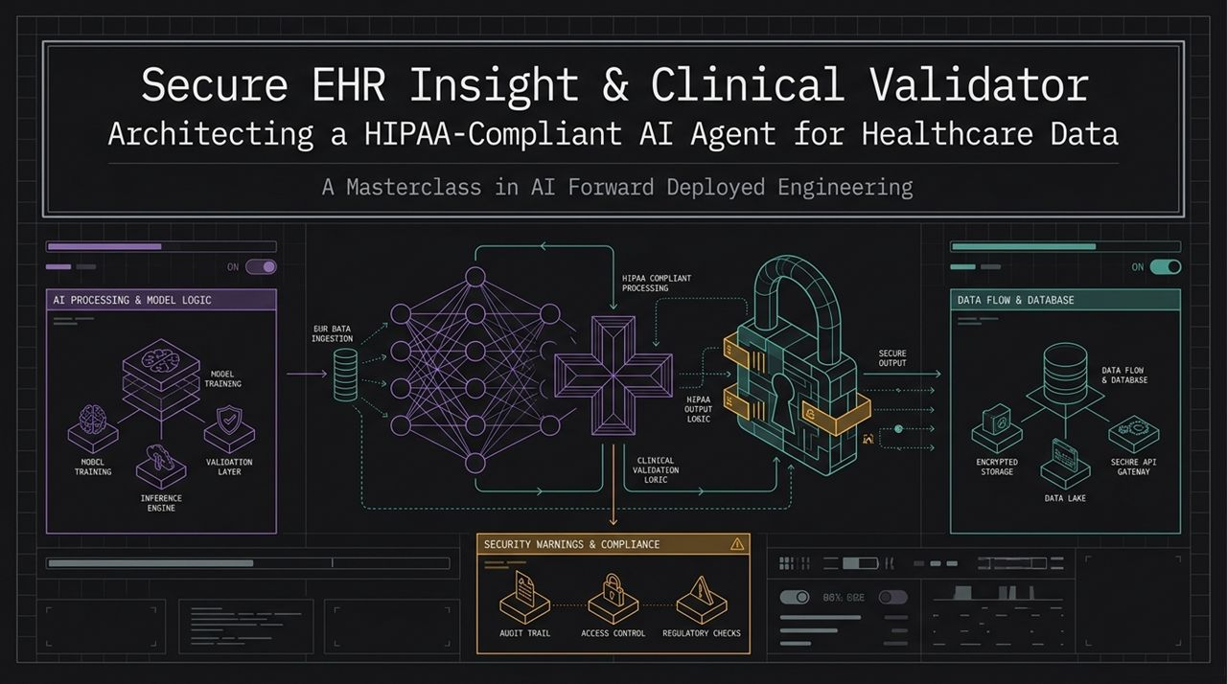
Notes:
Welcome & Introduction: Welcome everyone. Today, we are diving deep into building production-ready, secure clinical AI agents. Our focus is on bridging the gap between raw AI models and real-world enterprise requirements in healthcare.
The Core Architecture:
As you see on this slide, an enterprise clinical AI agent isn't just an API call to a Large Language Model.
It involves four synchronized components: the AI Processing & Model Logic layer, a HIPAA-Compliant Processing Pipeline, a robust Data Flow & Database structure, and strict Security Warnings & Compliance controls.
The High-Level Flow:
EHR data ingestion moves raw patient clinical data through an embedding and validation layer.
Before reaching any model reasoning engine, data goes through clinical validation and HIPAA output logic.
Behind the scenes, audit trails, access controls, and regulatory checks log every transaction.
Session Objective: By the end of this deck, you’ll understand how to engineer this system end-to-end—from cloud provisioning on AWS, database setup with vector capabilities, PHI sanitization, semantic guardrails, to containerized deployment.
https://www.youtube.com/watch?v=-4BrD23fQvU

Slide 2
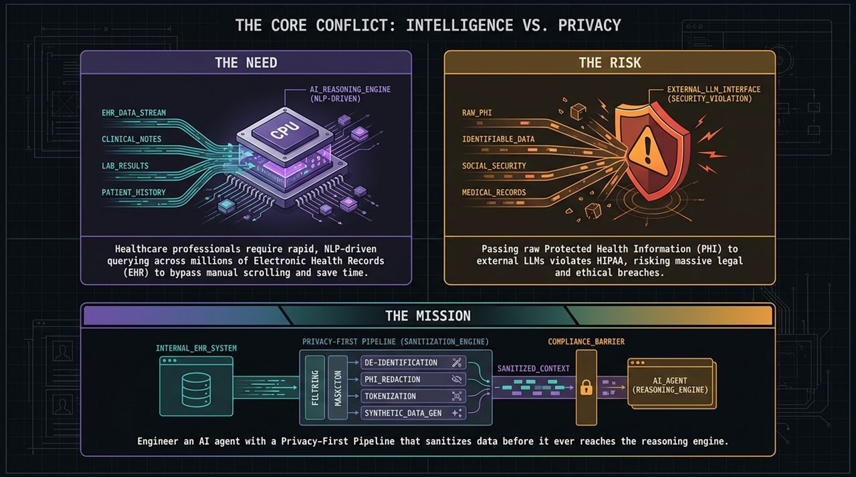
Notes:
The Industry Need:
Healthcare professionals are overwhelmed by manual data entry and searching.
To review a single patient's chart, doctors often scroll through thousands of lines of clinical notes, lab results, and historical diagnostic records.
Natural Language Processing (NLP) and LLM-driven query engines can save hours every day by extracting key insights instantly.
The Risk & Compliance Conflict:
However, passing raw Protected Health Information (PHI)—such as patient names, Social Security Numbers, or raw medical records—to third-party LLMs directly violates HIPAA regulations.
A single data leak or non-compliant API call risks massive legal penalties, loss of license, and severe ethical breaches.
The Mission:
Our engineering mission is clear: construct a Privacy-First Pipeline.
We must build a sanitization engine that sits between internal hospital systems and external reasoning models.
Data must be filtered, masked, de-identified, redacted, and tokenized so that only sanitized context reaches the reasoning engine.

Slide 3
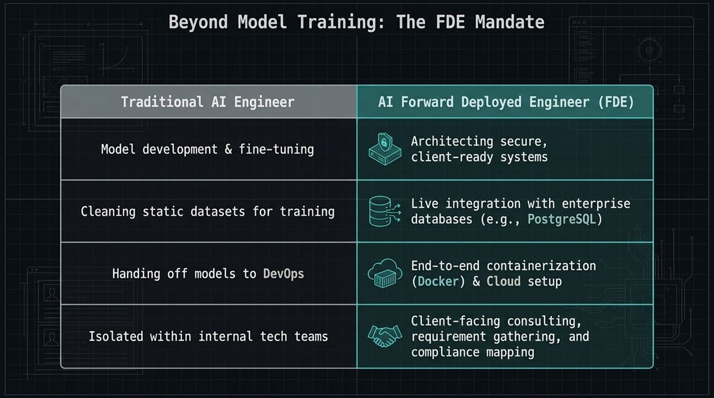
Notes:
Traditional AI Engineer vs. Forward Deployed Engineer (FDE):
In traditional settings, an AI engineer focuses primarily on model training, fine-tuning, evaluating metrics on static datasets, and handing model weights off to DevOps.
The FDE Mandate:
As a Forward Deployed Engineer (FDE), your scope expands significantly.
You aren't just training models in isolated Jupyter notebooks; you are architecting end-to-end, client-ready, secure enterprise systems.
Core FDE Responsibilities:
Live Integration: Integrating directly with live enterprise infrastructure (e.g., PostgreSQL databases).
Production Deployment: Containerizing the whole stack with Docker and deploying to cloud infrastructure like AWS EC2.
Compliance & Security Mapping: Working directly with stakeholders to ensure strict adherence to domain regulations like HIPAA and PHI protection.

Slide 4
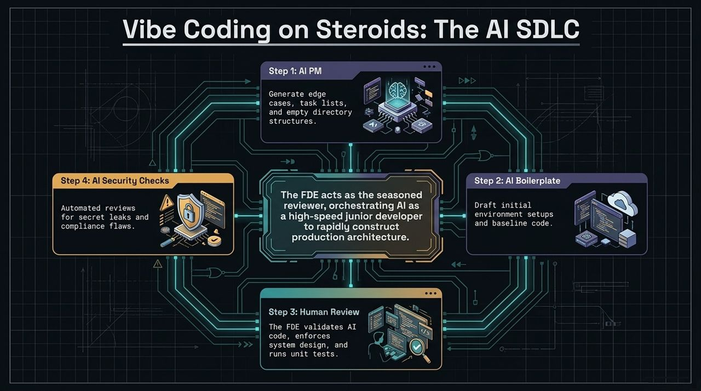
Notes:
Modern AI-Assisted Software Engineering:
The advent of high-capability LLMs has fundamentally altered the Software Development Life Cycle (SDLC).
We move away from writing every line of boilerplate code by hand toward orchestrating AI as a high-speed junior developer.
The 4-Step Cycle:
Step 1 (AI PM): Use AI agents to brainstorm edge cases, generate project structure specifications, task lists, and empty directory hierarchies.
Step 2 (AI Boilerplate): Let AI generate environment setups, initial API routes, and baseline data ingestion scripts.
Step 3 (Human Review): The FDE acts as the senior architect—validating code, enforcing system design patterns, and writing unit/integration tests.
Step 4 (AI Security Checks): Run automated reviews to detect potential secret leaks, hardcoded credentials, and compliance flaws.

Slide 5
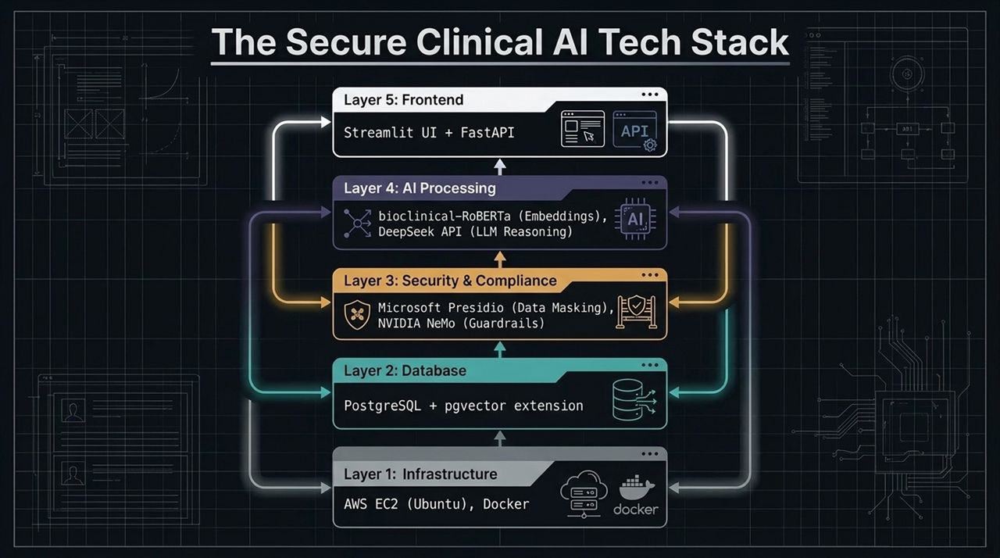
Notes:
Layer-by-Layer System Breakdown:
To build this system securely, we organize our architecture into 5 distinct, decoupled layers.
Layer 1 (Infrastructure): AWS EC2 (Ubuntu Linux) acting as our cloud host, managed via Docker containers for environment isolation.
Layer 2 (Database): PostgreSQL enhanced with the pgvector extension, allowing us to perform both relational querying and vector similarity searches in a single database.
Layer 3 (Security & Compliance):
Microsoft Presidio for real-time data masking and PHI redaction.
NVIDIA NeMo Guardrails for semantic rules and prompt enforcement.
Layer 4 (AI Processing): bioclinical-RoBERTa for generating high-precision medical embeddings, paired with DeepSeek API for clinical reasoning.
Layer 5 (Frontend / API): FastAPI backend serving low-latency REST endpoints coupled with a Streamlit dashboard UI.

Slide 6
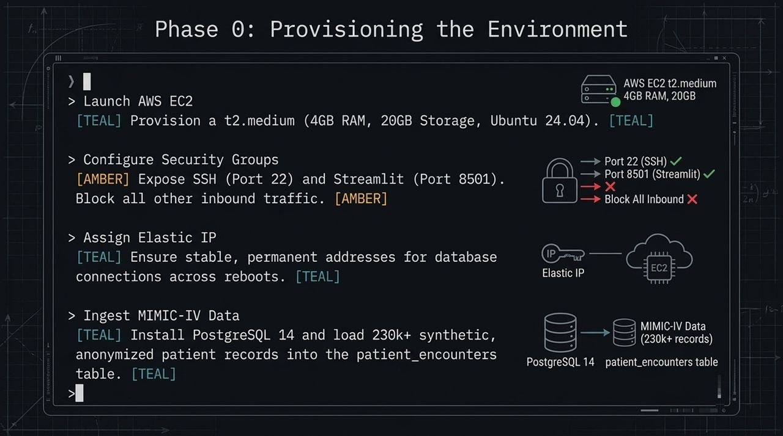
Notes:
Provisioning Compute:
Implementation starts with provisioning an AWS EC2 instance (t2.medium, 4GB RAM, 20GB storage running Ubuntu).
Network & Security Groups:
Security starts at the network boundary.
We configure EC2 Security Groups to open only essential ports: Port 22 for secure SSH admin access and Port 8501 for the Streamlit UI.
All other inbound public traffic is strictly blocked by default.
Static Addressing & Data Ingestion:
We assign an Elastic IP to maintain static database endpoints across reboots.
Next, we initialize PostgreSQL 14 and load 230,000+ synthetic, anonymized patient records (MIMIC-IV format) into our patient_encounters table.

Slide 7
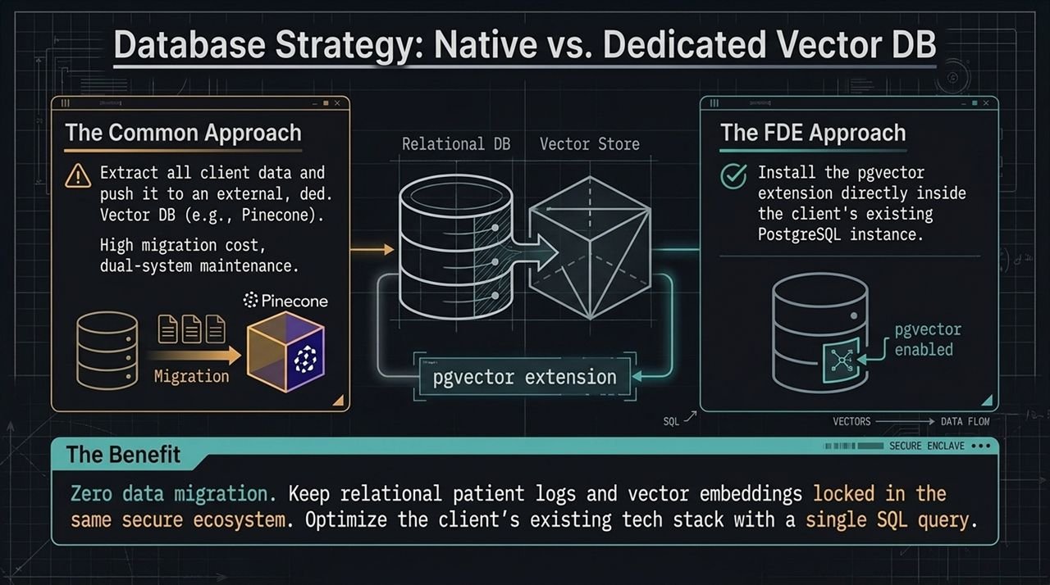
Notes:
The Common Pitfall:
When building RAG systems, developers often export raw enterprise data and send it to an external third-party vector database (e.g., Pinecone).
In healthcare, this adds massive compliance overhead, dual-system synchronization problems, higher migration costs, and expanded data surface attack areas.
The FDE Approach (pgvector):
Instead of moving data out, we bring vector search directly into the client's existing PostgreSQL instance using pgvector.
Key Strategic Benefits:
Zero Data Migration: Relational tables and vector embeddings stay co-located in the same secure database enclave.
Unified Querying: We can perform relational SQL filtering and cosine similarity searches within a single SQL statement.

Slide 8
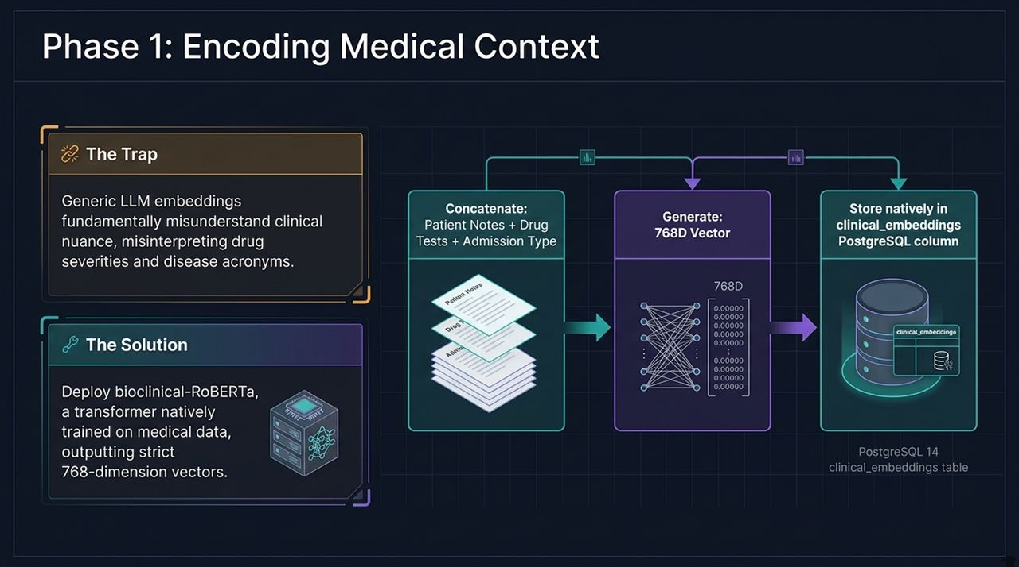
Notes:
The Embedding Problem:
Generic embedding models (like standard OpenAI or BERT models) fail on clinical text because they don't capture specialized medical terminology, acronyms, or drug relationships.
Domain-Specific Model Choice:
We utilize bioclinical-RoBERTa (or BioClinical-BERT), a transformer model pre-trained on clinical notes and biomedical literature.
It converts unstructured clinical notes, lab tests, and admission details into dense 768-dimensional vector representations.
Storage in PostgreSQL:
The generated 768D vectors are stored directly inside the clinical_embeddings column in PostgreSQL, enabled by pgvector.

Slide 9
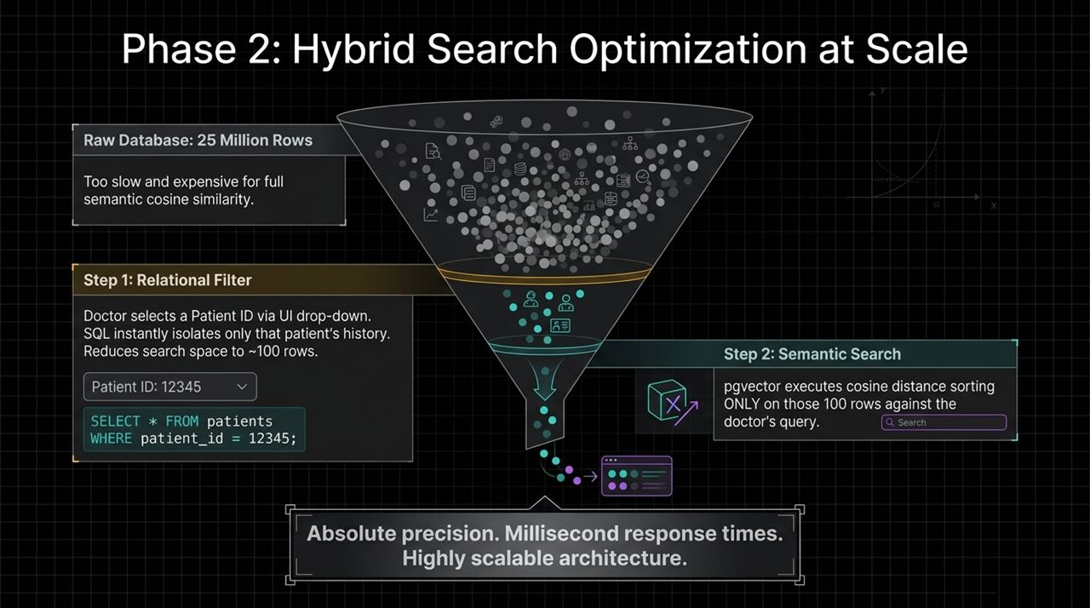
Notes:
Scaling Challenges:
Performing raw cosine distance searches across 25+ million rows in a enterprise database is computationally expensive and slow.
The Two-Step Hybrid Filter Strategy:
Step 1 (Relational SQL Filter): When a doctor selects a specific Patient ID in the dashboard UI, an initial SQL query isolates that exact patient's records.
This instantly cuts the search space from millions of rows down to roughly ~100 records.
Step 2 (Semantic Vector Search): pgvector performs cosine distance calculation only on those pre-filtered 100 rows matching the clinician's query.
Result: Absolute precision, sub-second latency, lower compute cost, and strict compliance isolation.

Slide 10
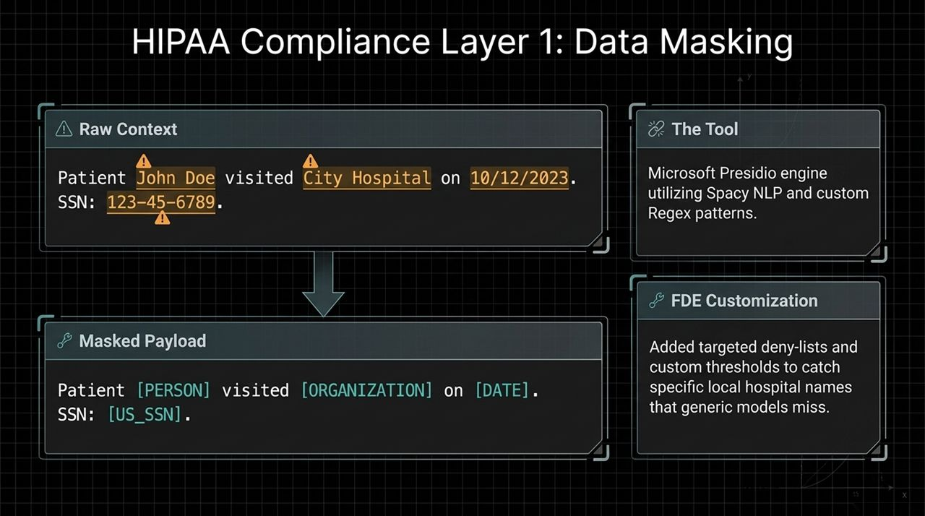
Notes:
The Redaction Engine:
Even with isolated search, retrieved context cannot be sent to an external LLM API if it contains Protected Health Information (PHI).
Tooling & Customization:
We implement Microsoft Presidio, combining spaCy NLP model pipelines with tailored Regular Expressions (Regex).
Presidio automatically scans the retrieved text and replaces sensitive elements with sanitized tokens (e.g., [PERSON], [ORGANIZATION], [DATE], [US_SSN]).
FDE Engineering Customizations:
Generic NLP models miss local hospital names, unique doctor acronyms, or region-specific identifiers.
We engineer custom deny-lists and fine-tune entity detection confidence thresholds to guarantee 100% anonymization before payload transmission.

Slide 11
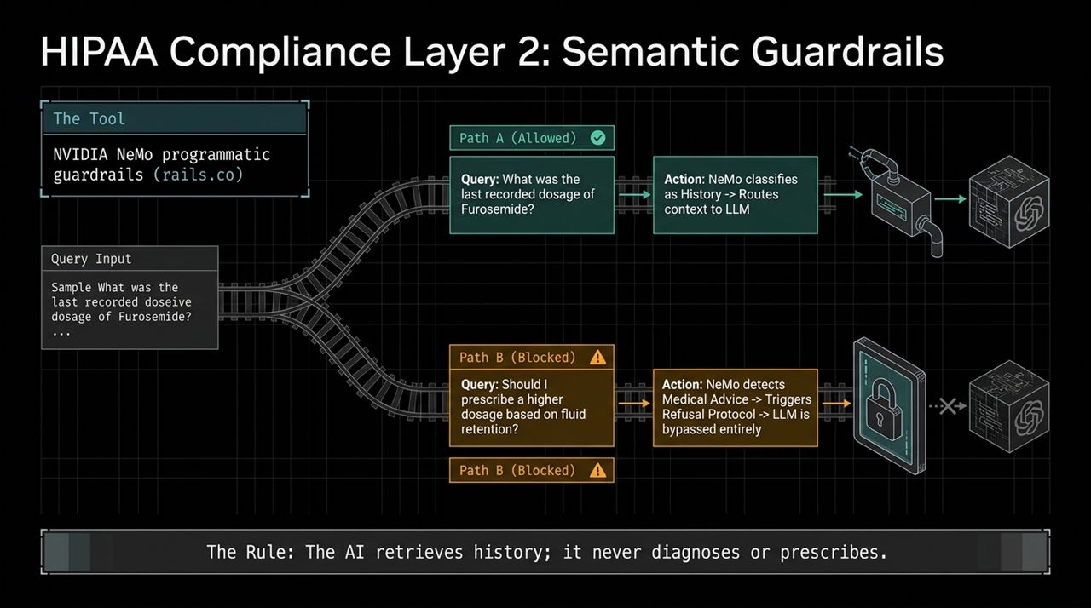
Notes:
Preventing Medical Advice & Liability:
An AI agent in a clinical environment must act strictly as an information retrieval assistant, never as a diagnostic or prescribing tool.
NVIDIA NeMo Guardrails:
We integrate NVIDIA NeMo Guardrails (rails.co) directly into the pipeline.
Dual Execution Paths:
Path A (Allowed - History Query): What was the last recorded dosage of Furosemide? → NeMo classifies this as a valid historical retrieval request and routes sanitized context to the LLM.
Path B (Blocked - Medical Advice): Should I prescribe a higher dosage based on fluid retention? → NeMo flags this as a medical decision/advice request, triggers an immediate refusal protocol, and bypasses the LLM call entirely.

Slide 12
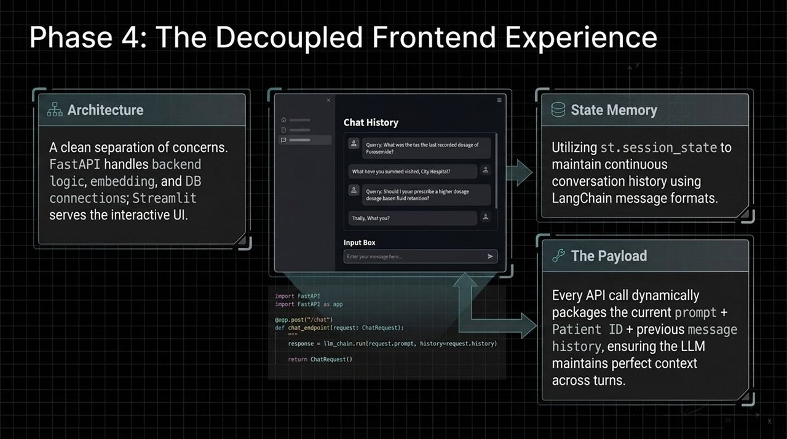
Notes:
Architecture & Separation of Concerns:
We maintain a strict separation between UI rendering and backend computation.
FastAPI handles routing, database connections, vector search execution, and compliance checking, while Streamlit presents a clean, responsive UI.
State Management:
Using st.session_state, Streamlit maintains conversation memory across multi-turn chats in LangChain-compatible message formats.
Payload Structure:
Every user request dynamically sends a payload containing the current prompt, selected Patient ID, and conversation history to FastAPI to maintain full context continuity.

Slide 13
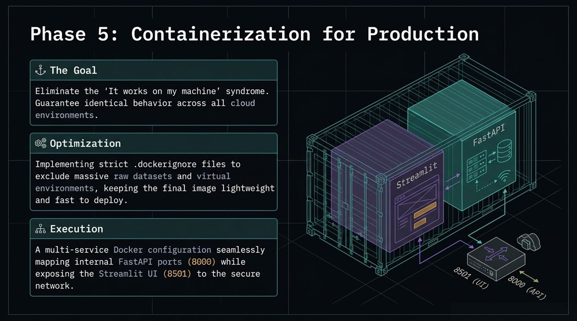
Notes:
The Engineering Objective:
Eliminate 'it works on my machine' issues by packaging the application into lightweight, reproducible environments.
Build Optimization:
We configure strict .dockerignore rules to exclude massive local dataset dumps, virtual environments, and build caches, keeping image sizes small and deployment fast.
Multi-Container Orchestration:
We configure Docker containers mapping FastAPI internal service ports (8000) and exposing Streamlit web ports (8501) onto our secure AWS virtual network.

Slide 14
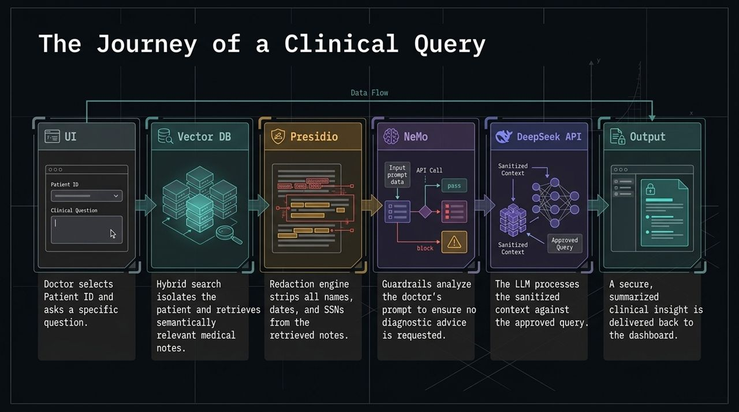
Notes:
Step-by-Step Query Execution Flow:
UI Selection: A doctor selects a Patient ID and types a specific clinical question into Streamlit.
Vector DB Filtering: FastAPI triggers hybrid search in PostgreSQL (pgvector), isolating the patient and retrieving relevant medical notes.
Presidio Redaction: Microsoft Presidio strips all PHI (names, dates, SSNs) from the retrieved notes.
NeMo Guardrails: NeMo checks the prompt intent to ensure no medical/diagnostic advice is requested.
DeepSeek API Reasoning: The sanitized context and approved prompt are sent to the LLM API for summarization.
UI Output: A concise, sanitized clinical response is delivered back to the clinician dashboard.

Slide 15
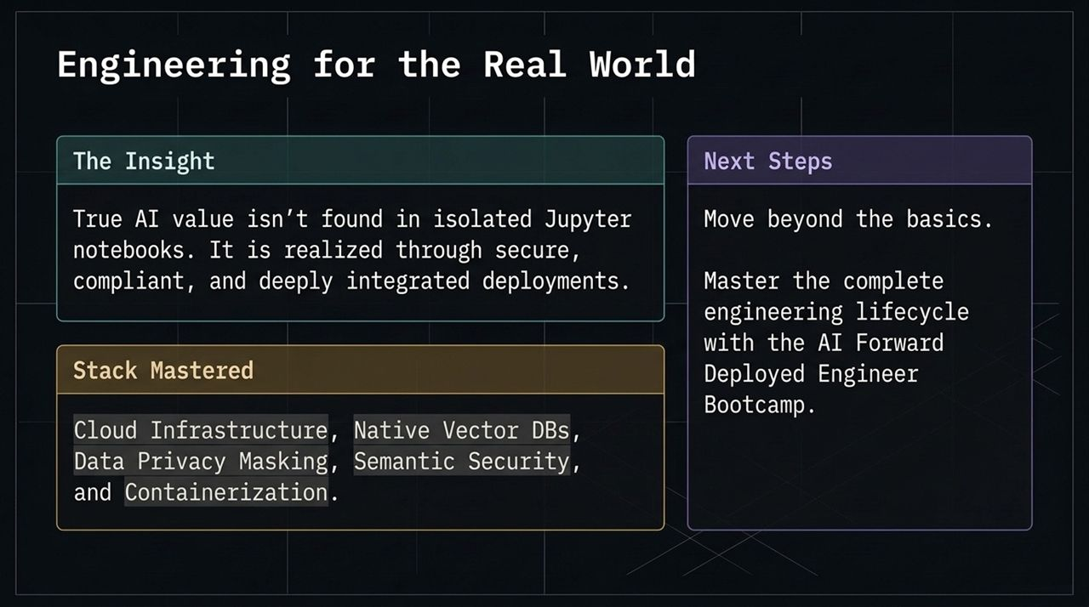
Notes:
https://www.youtube.com/watch?v=-4BrD23fQvU
Core Takeaways:
Real-world enterprise AI impact isn't created in isolated Jupyter notebooks.
Value is realized when models are wrapped in secure, compliant, low-latency infrastructure.
Mastered Capabilities:
Cloud infrastructure setup on AWS EC2.
Native vector search integration via PostgreSQL pgvector.
Programmatic PHI redaction and semantic security guardrails.
Decoupled API design and containerized deployment with Docker.

Slide 16
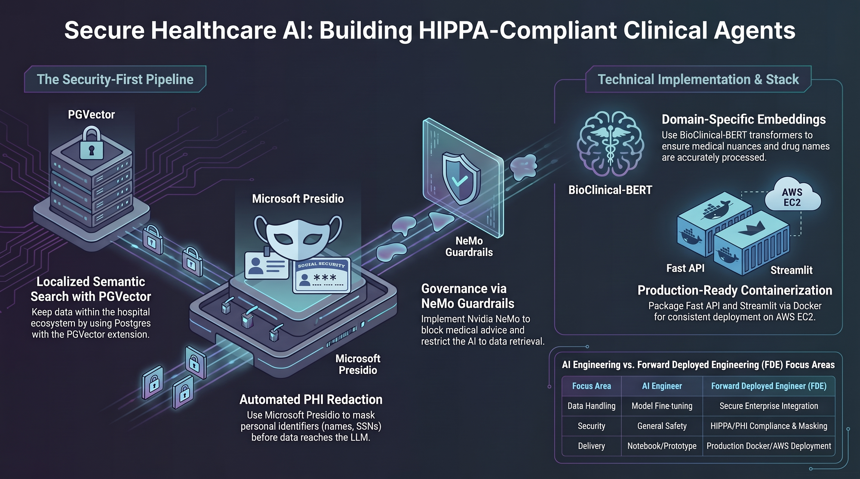
Notes:
Final Architectural Recap:
Domain Embeddings: BioClinical-BERT / bioclinical-RoBERTa for accurate medical terminology processing.
Localized Storage: pgvector keeps patient data within the hospital DB enclave.
Data Privacy: Microsoft Presidio automates PHI masking prior to external API transmission.
Governance: NVIDIA NeMo Guardrails restrict AI to historical retrieval only.
Deployment: FastAPI + Streamlit containerized with Docker on AWS EC2.
Closing Distinction:
While traditional AI engineers focus on fine-tuning models and notebooks, Forward Deployed Engineers deliver production-grade, secure, HIPAA-compliant systems built to solve real enterprise challenges.

